Slide 1
Enter the Tidyverse:
Tips & tricks for tidy R project organization
Meredith Brown
R-Ladies Boston
March 21, 2019
https://github.com/gitmab/ratstats/

Slide 2
Different workflows for different business/research contexts
Script -> PowerPoint
Multiple scripts for bigger projects
RMarkdown reports
sweave/knitr -> LaTeX
Shiny for interactive data exploration

Slide 3
Example project: Somerville 311 data

Slide 4
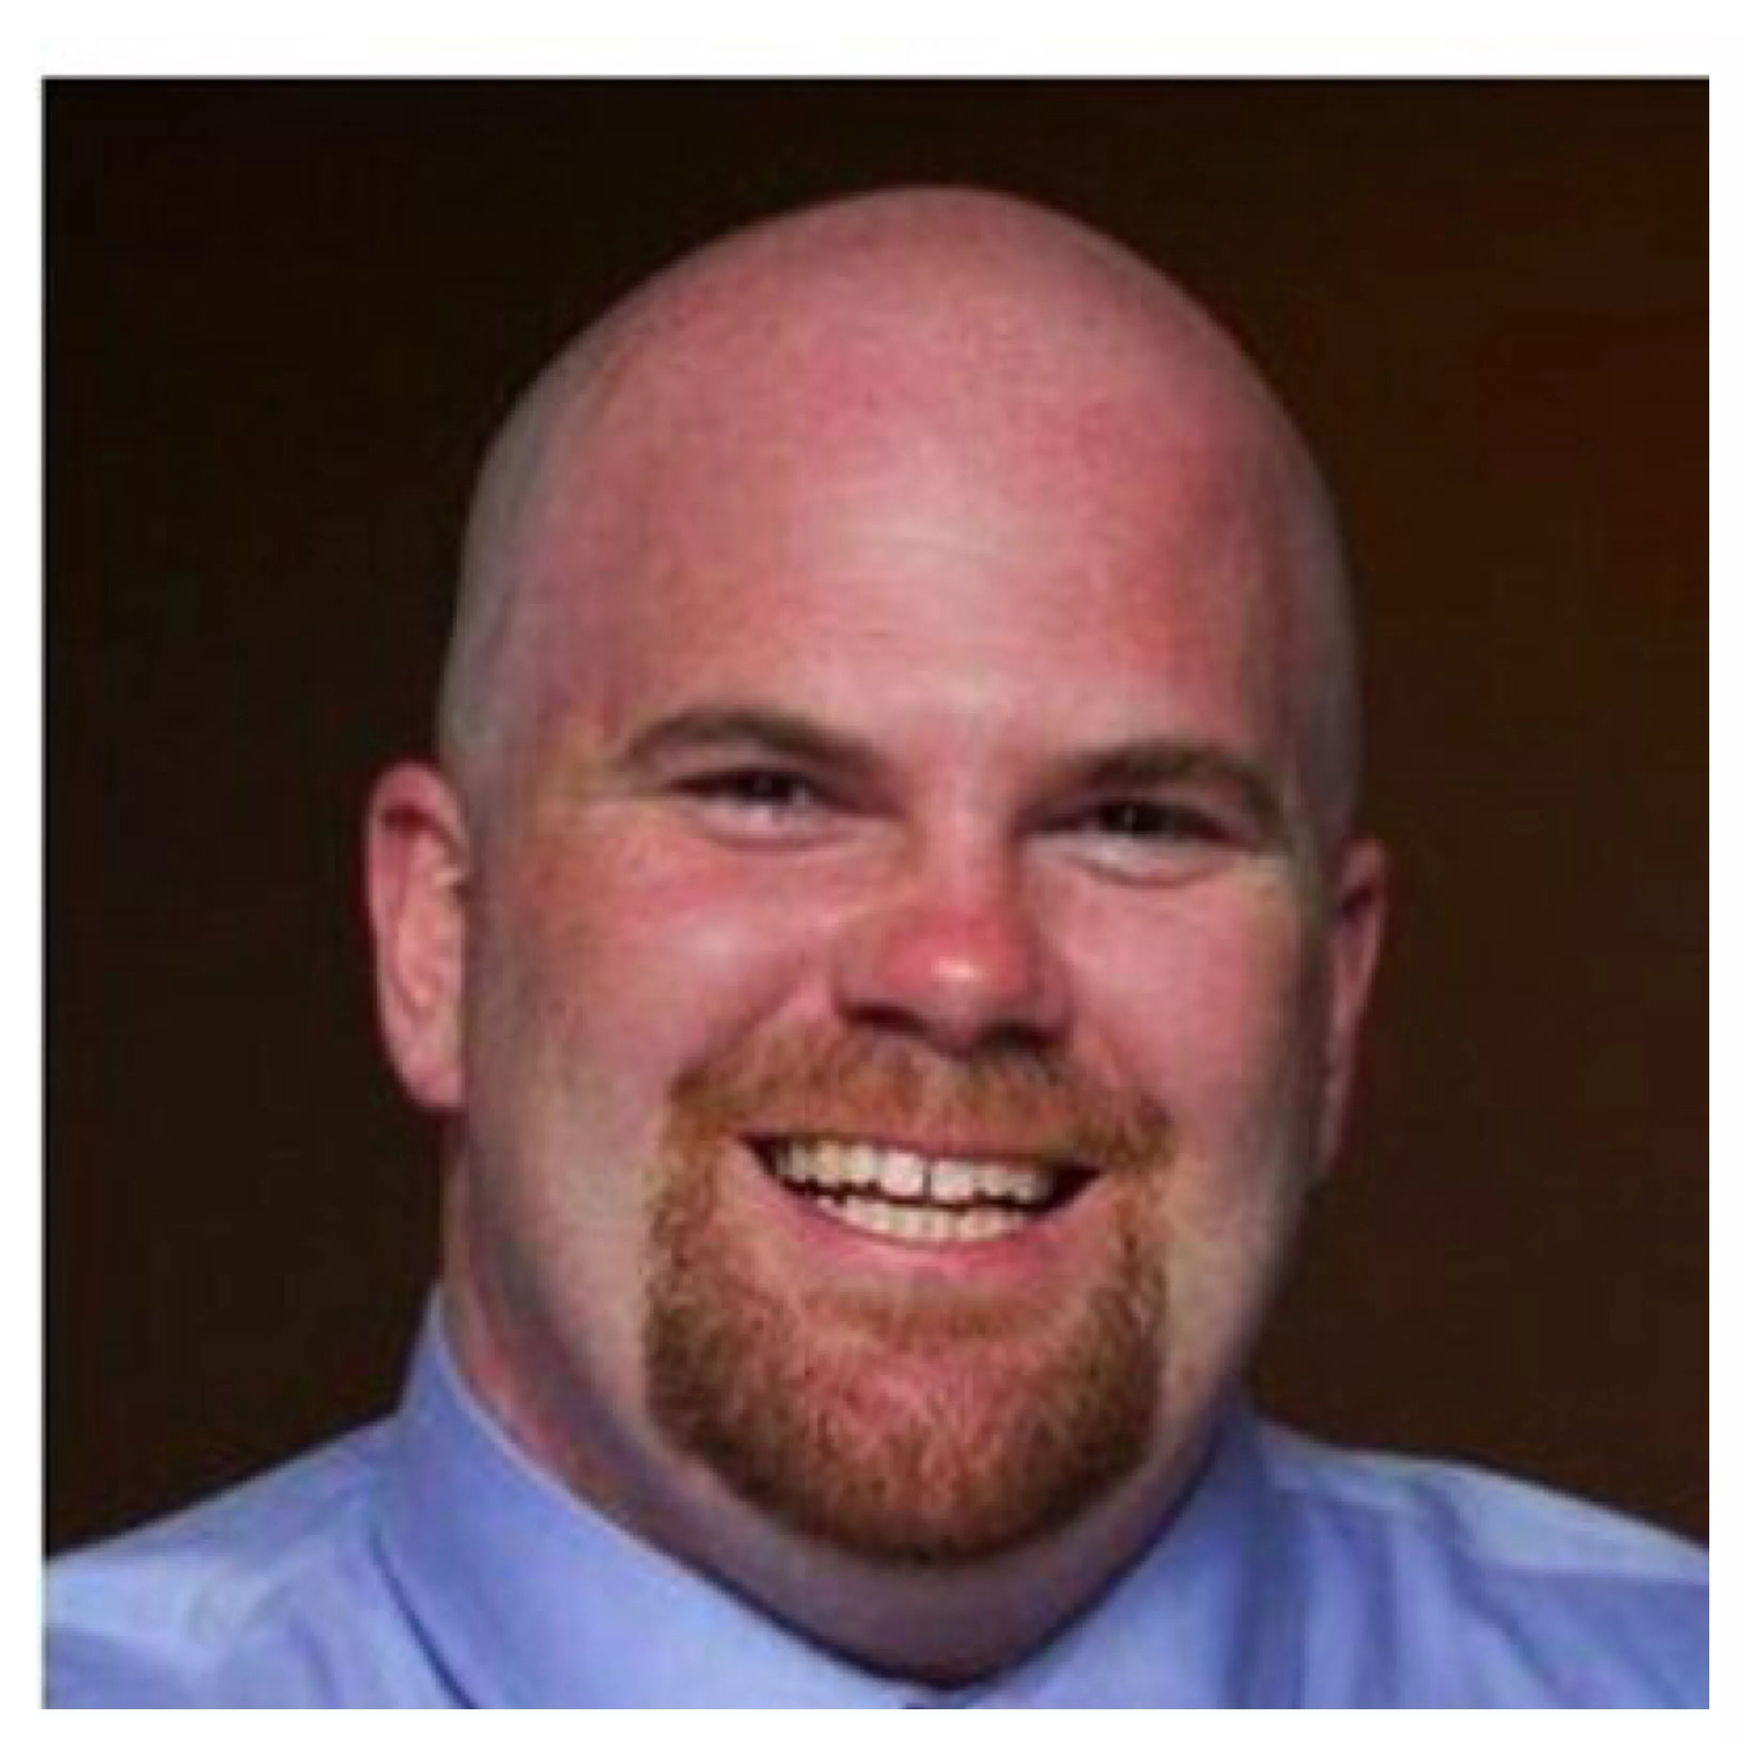
Matt McLaughlin

Slide 5
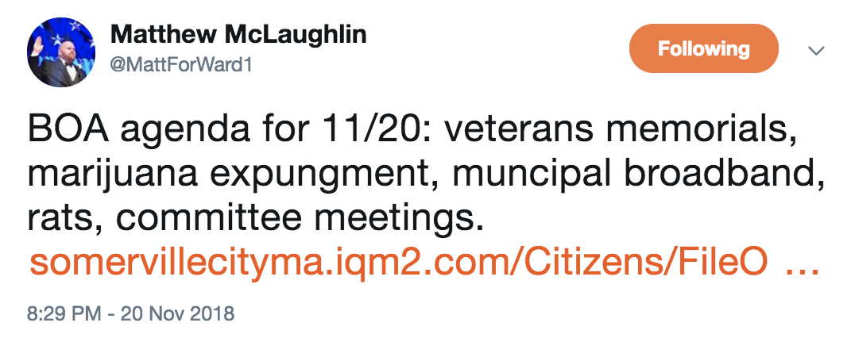
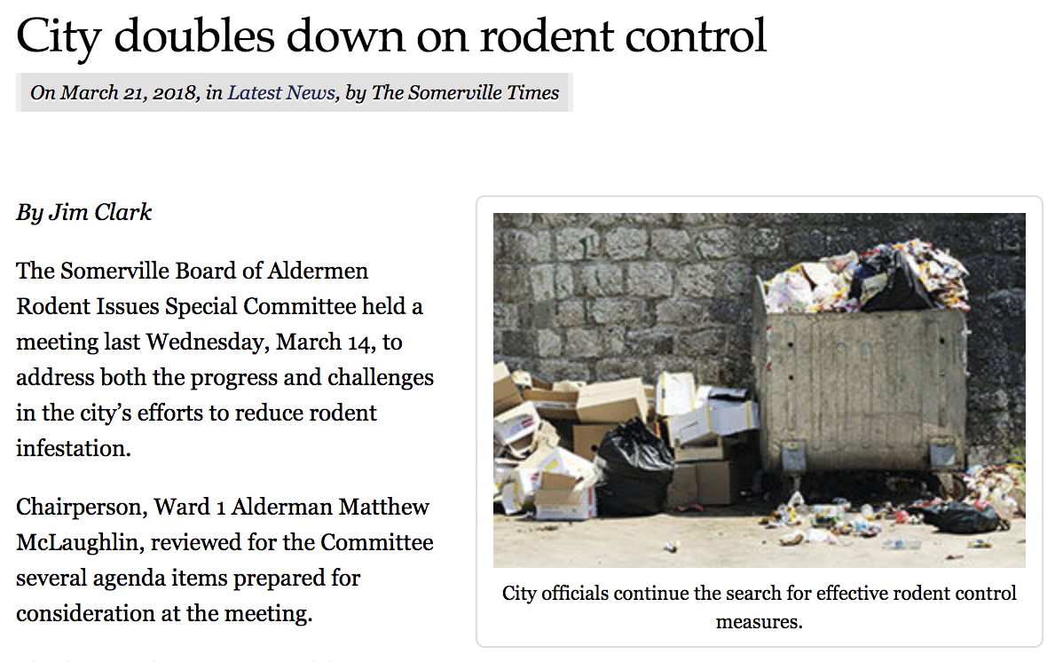
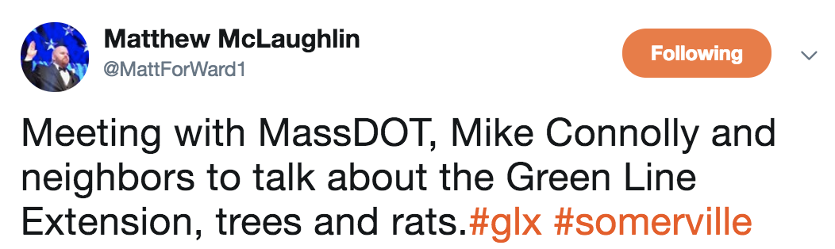
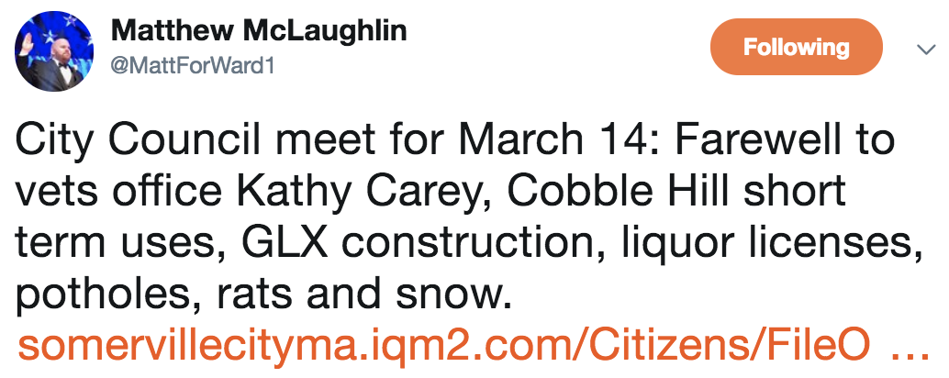
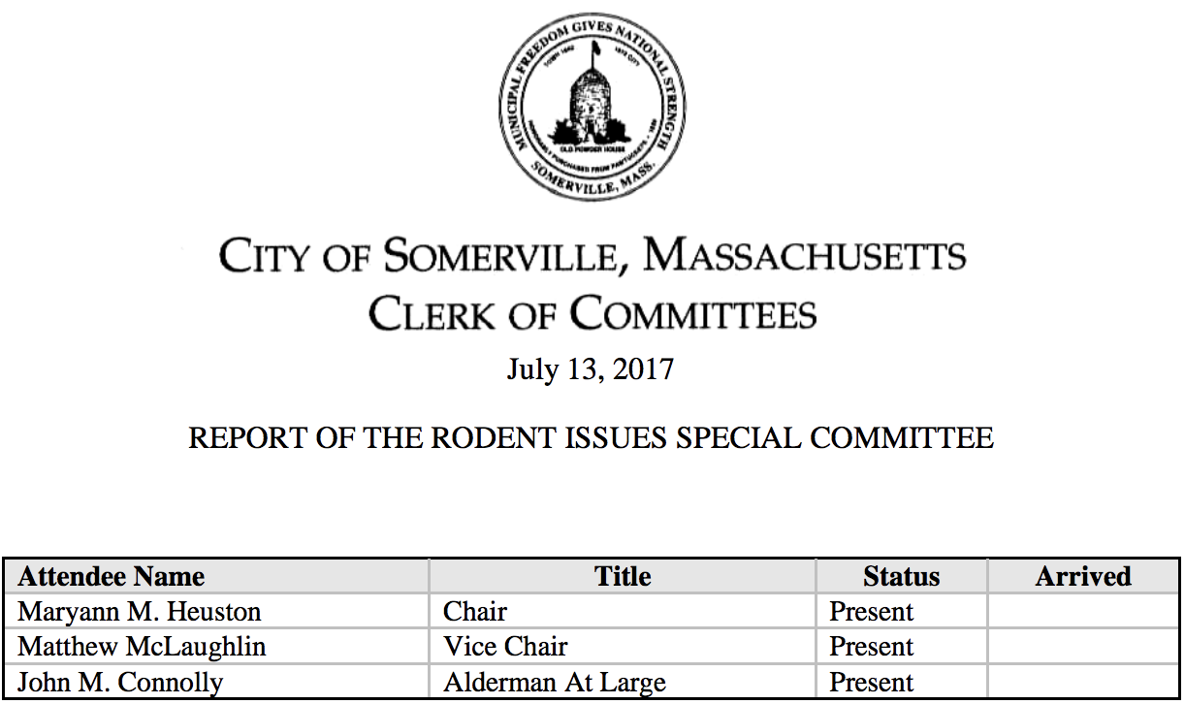
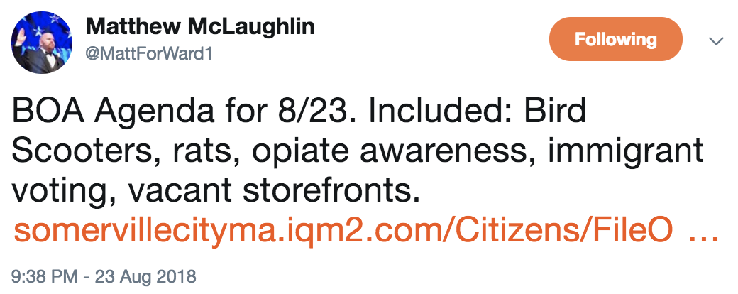
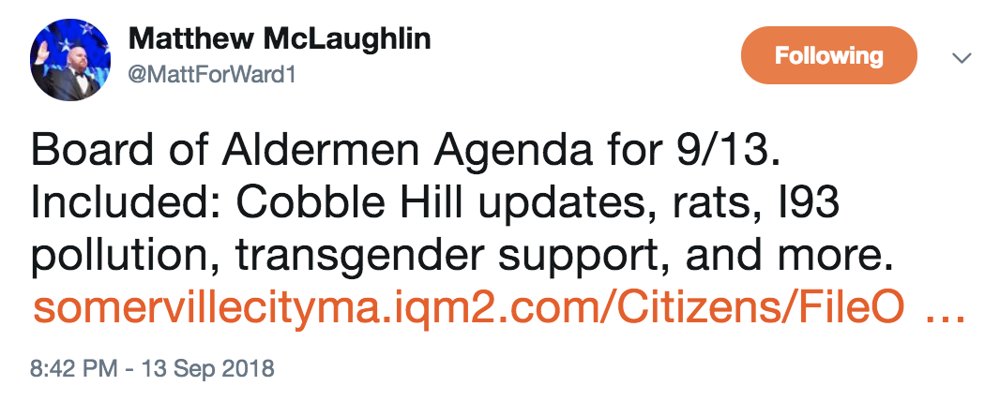
Matt vs. the rats

Slide 6
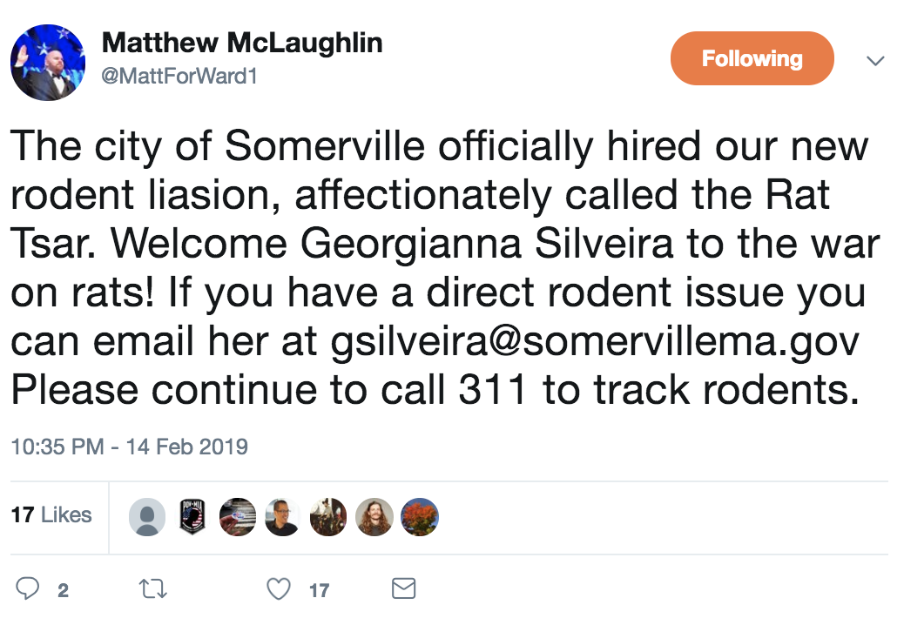
Somerville has a Rodent Liaison

Slide 7
Rat questions
Is the rat situation in Ward 1 much worse than in other wards?
How has reported rat volume changed over time?
What are current rat “hot spots”?
Address using Somerville 311 work order data
Notes:
Go to R script

Slide 8
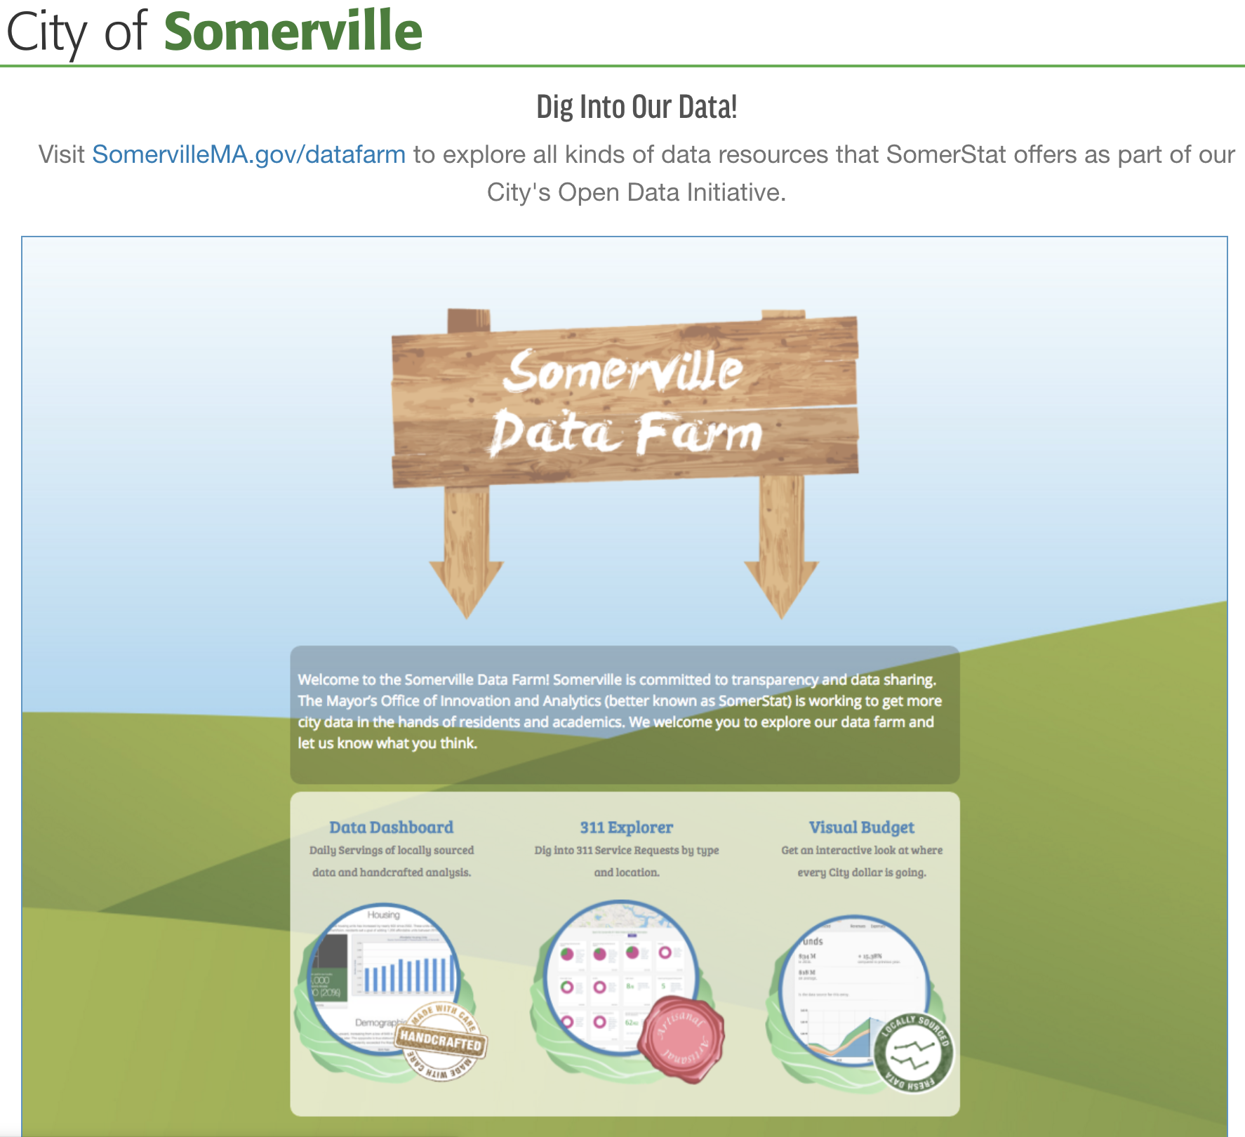
SomerStat Open Data Initiative

Slide 9
Different workflows for different business contexts
Script -> PowerPoint
Multiple scripts for bigger projects
RMarkdown reports (with Tidyverse style tips!)
sweave/knitr -> LaTeX
Shiny for interactive data exploration
https://github.com/gitmab/ratstats/

Slide 10
Workflow 3: RMarkdown reports

Slide 11
RMarkdown reports
Situation: Informal, more technical research report or presentation (e.g. lab meeting), blog post, or documentation for data challenge
Can put more emphasis on process

Slide 12
Workflow 1: Script to PowerPoint

Slide 13
Script to PowerPoint
Situation: Analysis/modeling with updates delivered to business partners at regular intervals
Pre-emptively capturing main insights and plots from analysis in PowerPoint saves time and effort
Also a good, easy way to update internal project team about progress & get quick feedback

Slide 14
Seasonal rat trends by ward
Annual peaks in rat call volume during summer months
Wards 1-3 most affected
Injured and dead animal reports are similar to rat reports in volume, ward distribution, and seasonality

Slide 15
311 calls from Wards 4-7 on the rise
Looking at total number of 311 work orders by ward shows very little 311 data from Wards 4-7 until 2018

Slide 16
Ward 1 has highest relative rate of rat complaints for 2018-2019

Slide 17
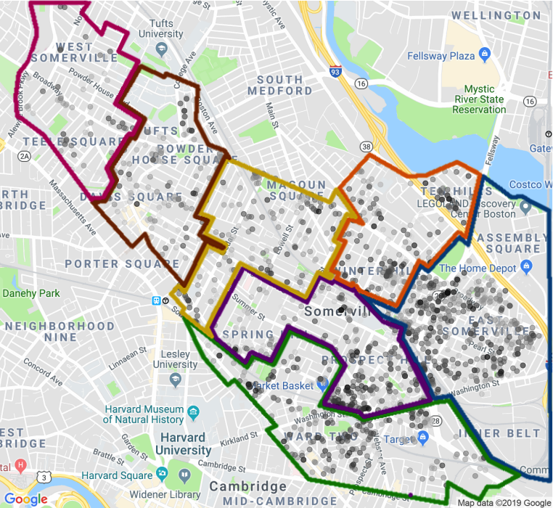
Map of rat-related 311 work orders
March 2019
July 2015

Slide 18
Workflow 2: Multiple scripts for bigger projects

Slide 19
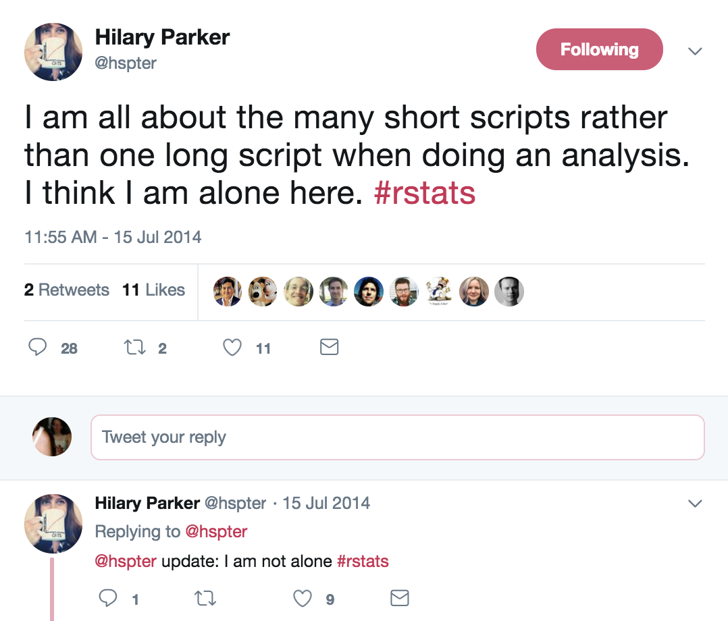
Multiple scripts for bigger projects

Slide 20
Multiple scripts for bigger projects
Situation: Script has become large, unwieldy, less readable and interpretable
Solution: Divide into multiple scripts
Sequential scripts:
01_setup.R
02_processing.R
03_plot_by_time.R
04_maps.R
Main + helper scripts:
ratstats_main.R
source(ratstats_utils.R)
Academic project:
project_data_processing.R
project_stats_tables.R
project_figures.R

Slide 21
Workflow 4: sweave/knitr to LaTeX

Slide 22
sweave/knitr to LaTeX
Situation: Automatically populating dynamic, reproducible reports and academic papers
More polished/formal than RMarkdown reports
Resources:
https://www.r-bloggers.com/writing-academic-articles-using-r-sweave-and-latex/
https://rpubs.com/YaRrr/SweaveIntro
http://bcb.dfci.harvard.edu/~aedin/courses/ReproducibleResearch/ReproducibleResearch.pdf

Slide 23
Workflow 5: Shiny app

Slide 24
Shiny app
Situation: Enabling collaborators or stakeholders (or just yourself) to interactively explore data
Good for building intuition about complex data sources and eliciting insights from subject matter experts

